Slide 1
Steam price predictor
Zachary Breen

Slide 2
Why Steam?
Steam is the largest PC gaming platform with a wide variety of games and services.
On top of if the item is a game they also sell applications for video editing, design and other applications.
The price model of Steam is to have regular sales across a large range of items. Predicting the current price of a game is relevant to current sales as well as the popularity of the game and the current price model.

Slide 3
The Journey of the “why”
The original goal was to look at how microtransactions were affecting the video game market with lowering the buy price in order to purchase more items in store. The goal was to look across PC and consols and see how game costs changed over time depending on the available data. 4
Data around microtransactions was particularly hard to find. Total data was available, but either the cost of items was incomplete or it wasn’t available at all.
What I was eventually able to find was data relating directly to the cost of a game from the time of release to current.
However, I was only able to find this for one service (steam)

Slide 4
Tools used:
Pandas in Jupyter Notebook
MongoDB
Seaborn
Matplotlib
Sci-Kit Learn
HTML/CSS
Pickle
Flask
Heroku

Slide 5
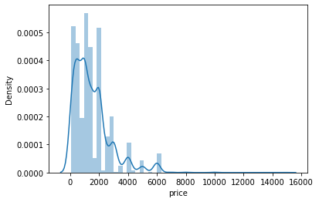
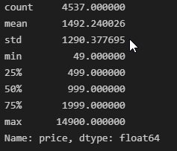
Analyzing price as a variable

Slide 6
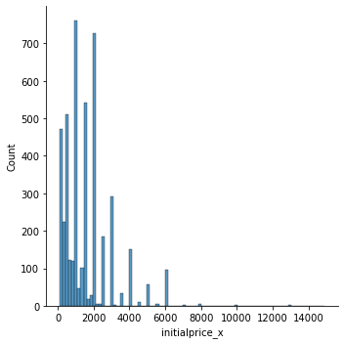
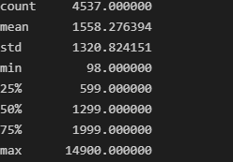
Comparing to initial price

Slide 7
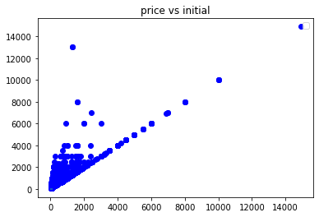
Current price vs initial price

Slide 8
Finding data
Steam basic api = https://partner.steamgames.com/doc/webapi_overview
Steam spy api = https://steamspy.com/api.php
The two api services above allowed me to gather the following data:
App Name
Price
Reviews
Publisher
Developer
Genres
Content
tags
Initial price
Discount
Current player base (concurrent users, average time played, total time played, last two weeks played)
Support provided

Slide 9
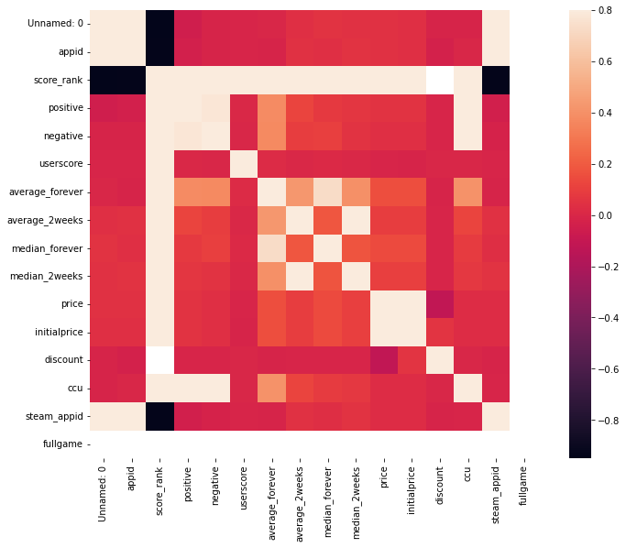
Data exploration
Evolving the data to a point where it
could be modelled became a tricky goal.
My original correlation analysis was:

Slide 10
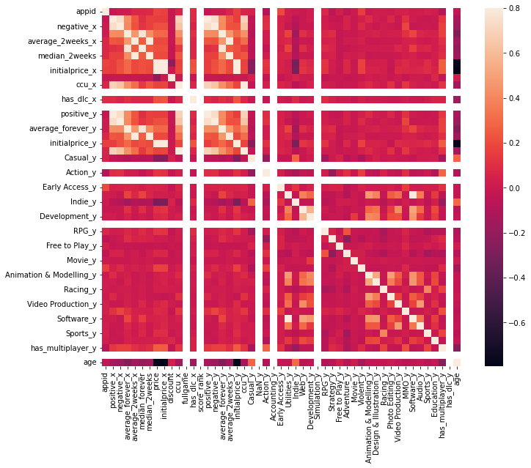
Creating more
meaningful
correlations
Created new columns that included: Length of time the game has been on Steam
Ownership (previously a range)
Each individual genre
DLC functionality
Multiplayer functionality
The chart now has 60 variables

Slide 11
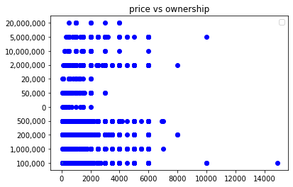
Price vs ownership

Slide 12
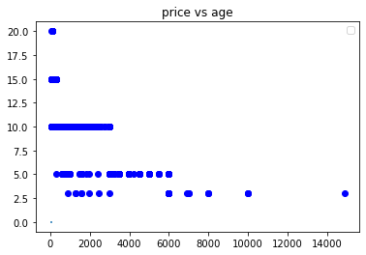
Price v Age

Slide 13
Modelling
Tested using 4 different models to find different results:
Linear Regression
Logistic Regression
Decision Tree
Random forest
The best result was using the Decision Tree, which gave me an accuracy of 54% and a mean squared error of 10. The price distribution is across 1000’s, so this was a good fit.

Slide 14
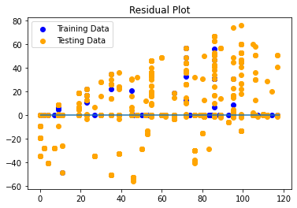
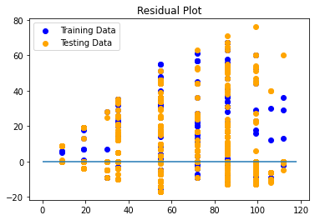
Logistic vs Tree
Tree plot
Mean Squared error = 1.5c
R squared = .997
Logistic plot
Mean error = 11.9c
R squared = .84

Slide 15
Conclusion
Challenges
Key takeaways
If I could start again

